Slide 1
Lessons Learned in the Decade Since the San Pedro Capture Map
Stan Leake
U.S. Geological Survey, Retired Stanley A. Leake Hydrology
Sierra Vista sub-Basin TAC August 15, 2018

Slide 2
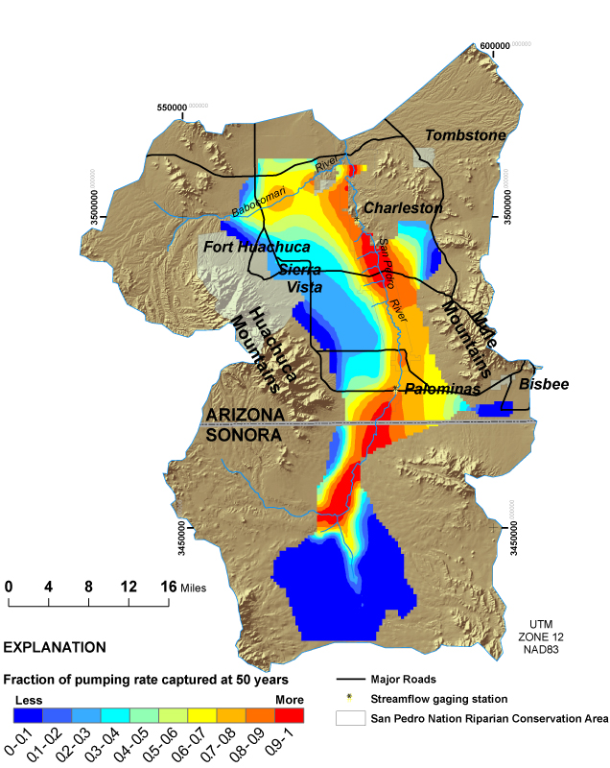
Computed capture by pumping for 50 years

Slide 3
Constructing the Capture Map
To preserve linearity, the starting point for capture simulations was predevelopment conditions (1902). The river was simulated as through-flowing at that time.
A computer program ran the model repeatedly, each time with a low-rate pumping well in a different location in the lower basin-fill aquifer.
Capture values were contoured at specific times– 10, 50, and 100 years, to make capture maps for those times.

Slide 4
Impact
The local water community in the Upper San Pedro Basin embraced the capture map as a way to understand the timing of effects of pumping on the river.
Several dozen scientific papers have referenced the Capture Map, with some of them recreating it with different methodologies.
… but what are the best uses of the Capture Map for today’s upper San Pedro River?

Slide 5
Educating People on the Somewhat Obvious
If you pump or recharge water close to the river, effects on surface water will occur relatively quickly.
Response time increases with increasing distance from the river.
Glover’s analytical solution for capture:
Q_{s} = Q_{w} erfc( z ); z = (d²S )/(4Tt)

Slide 6
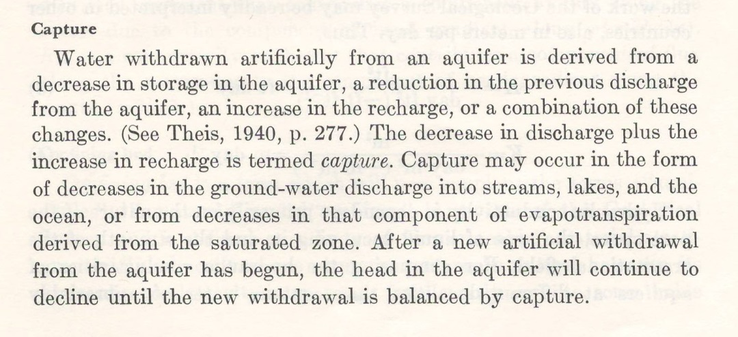
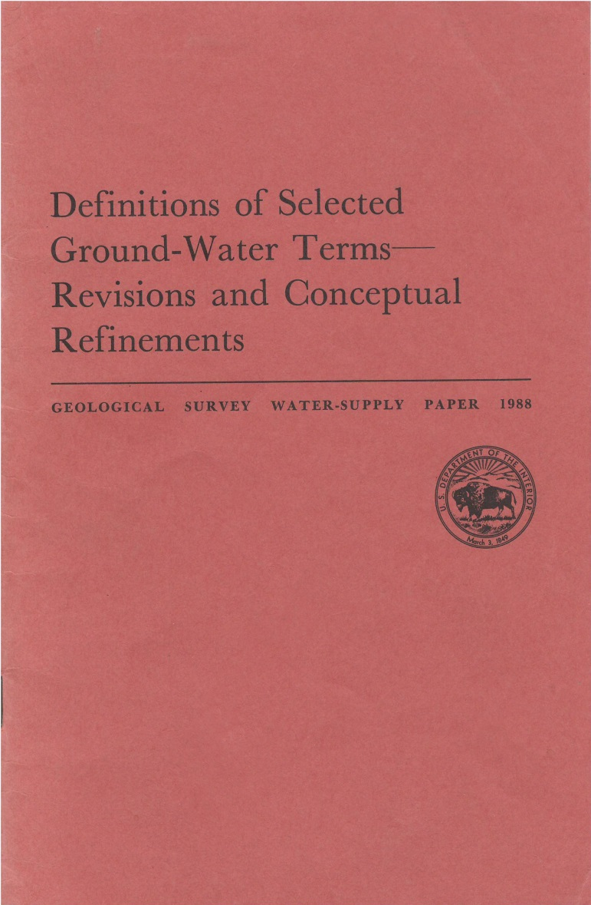
Capture
For capture to occur, there must be a decrease in the discharge rate from, or an increase in the recharge rate to, an aquifer.
Notes:
Emphasize that there has to be an increase in recharge and (or) decrease in discharge.

Slide 7
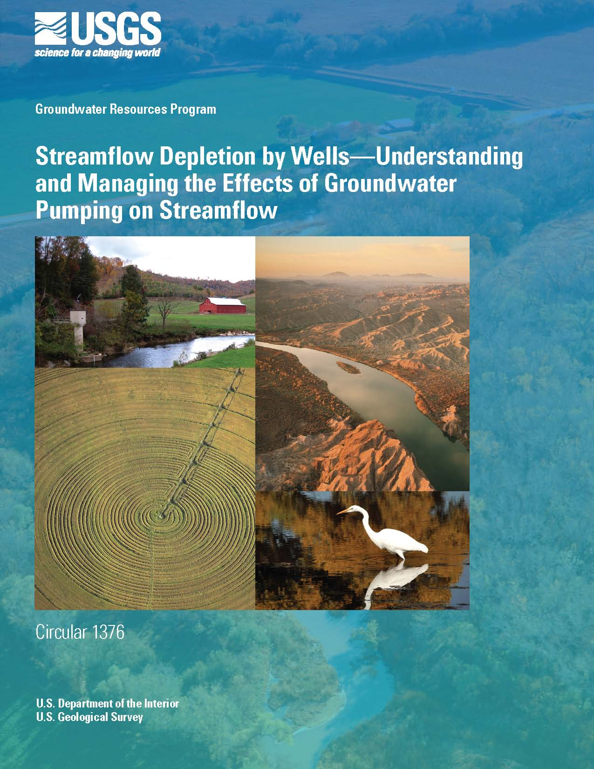
Streamflow Depletion
A reduction in streamflow caused by groundwater pumping.

Slide 8
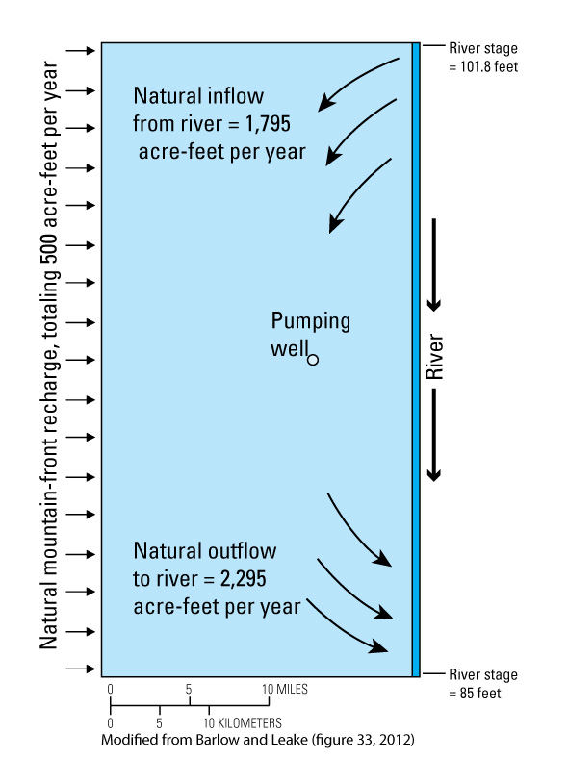
Typical situation
In most settings, capture from a stream or river consists of
(increased inflow from SW)
+
(decreased outflow to SW)
Streamflow depletion at the downstream end of the system equals capture.

Slide 9
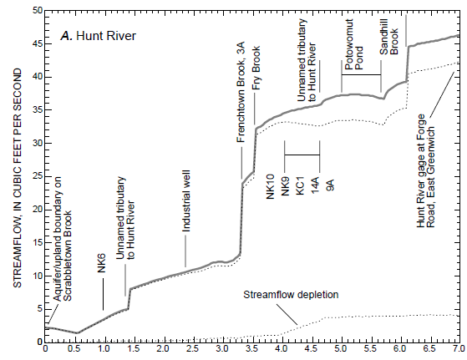
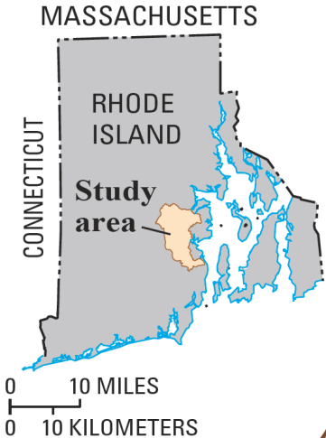
Example: Hunt River Basin, RI
No withdrawals at public-supply wells
With withdrawals
No withdrawals at public-supply wells
With withdrawals
At outflow of basin, total streamflow depletion is equivalent to the amount of streamflow depletion captured by the wells.
DISTANCE ALONG HUNT RIVER, IN MILES

Slide 10
Sources of Water to a Pumped Well
1.0
0.9
0.8
Capture, possibly including: - increased inflow from SW - decreased outflow to SW - reduced ET
0.7
0.6
FRACTION OF PUMPING RATE
0.5
0.4
0.3
Change in GW storage
0.2
0.1
0.0
0
10
20
30
40
50
60
TIME, IN YEARS
The timing of capture depends on
Aquifer diffusivity (T/S)
Distance to connected SW features
Notes:
More model results: This graph shows the sources of water to the pumped well in the last slide as a function of time.
With time, the proportion from storage diminishes and the proportion from depletiond streamflow increases.

Slide 11
Two cases where streamflow depletion is not capture
A— Streams that lose all water to the aquifer prior to pumping.
B— Isolated perennial stream reaches.

Slide 12
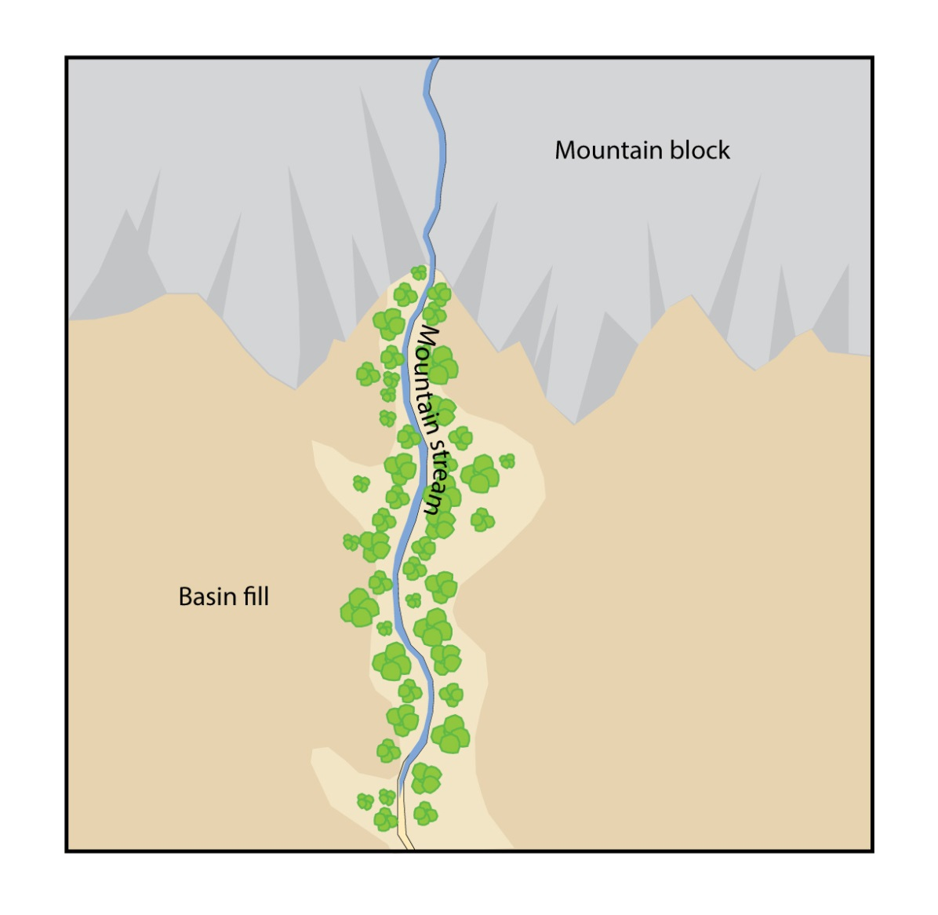
Case A
A— A stream with mountain runoff enters the basin and all of the flow recharges the aquifer.
Notes:
First example of a feature at which capture of streamflow does not occur is shown in the next three slides. Here is a stream that enters from a mountain block and loses all of its water to the aquifer over some distance from the mountain front. Let’s assume that amount of loss is 2cfs.

Slide 13
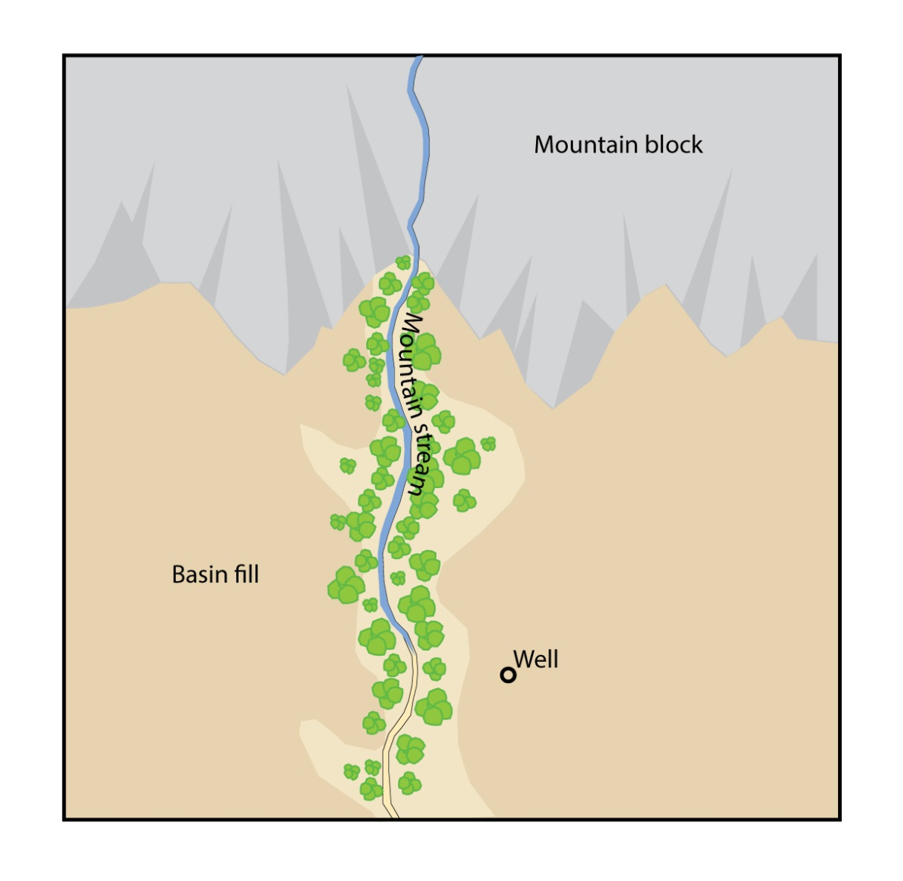
Case A
A— A well pumps water near the perennial part of the stream.
Notes:
Drawdown from a pumping well can cause the streamflow to infiltrate over a shorter interval. The amount of infiltration that is a source of water to the aquifer, however, cannot be changed by the groundwater pumping. Possibly give a hypothetical example that 2 cfs flows in from the stream at the mountain front. The well cannot cause more than 2 cfs to enter the aquifer. For capture to occur, there must be either an increase in R or decrease in D, but here, there is no net decrease in D although depletion has occurred. The capture actually occurs downgradient someplace, such as capture of ET.

Slide 14
Case A
Pumping reduces the flow in the stream; therefore, streamflow depletion occurs from groundwater pumping.
If the entire amount of water from the stream infiltrates without groundwater pumping, that same amount of water will infiltrate with groundwater pumping. No additional inflow from surface water is possible; therefore, capture of streamflow does not occur.
There may be other sources of capture for this feature:
Reduced evapotranspiration along the stream reach.
Infiltration of runoff that was rejected when the water table was at the stream channel prior to pumping.
Notes:
This slide summarizes the effects that streamflow depletion from groundwater pumping occurs but capture, in this case increases in recharge, does not occur. We need to acknowledge that capture of ET and rejected runoff can occur. An important point about rejected recharge is that capture has to be infiltration of runoff that previously flowed out of the area, not water that infiltrated further downstream.

Slide 15
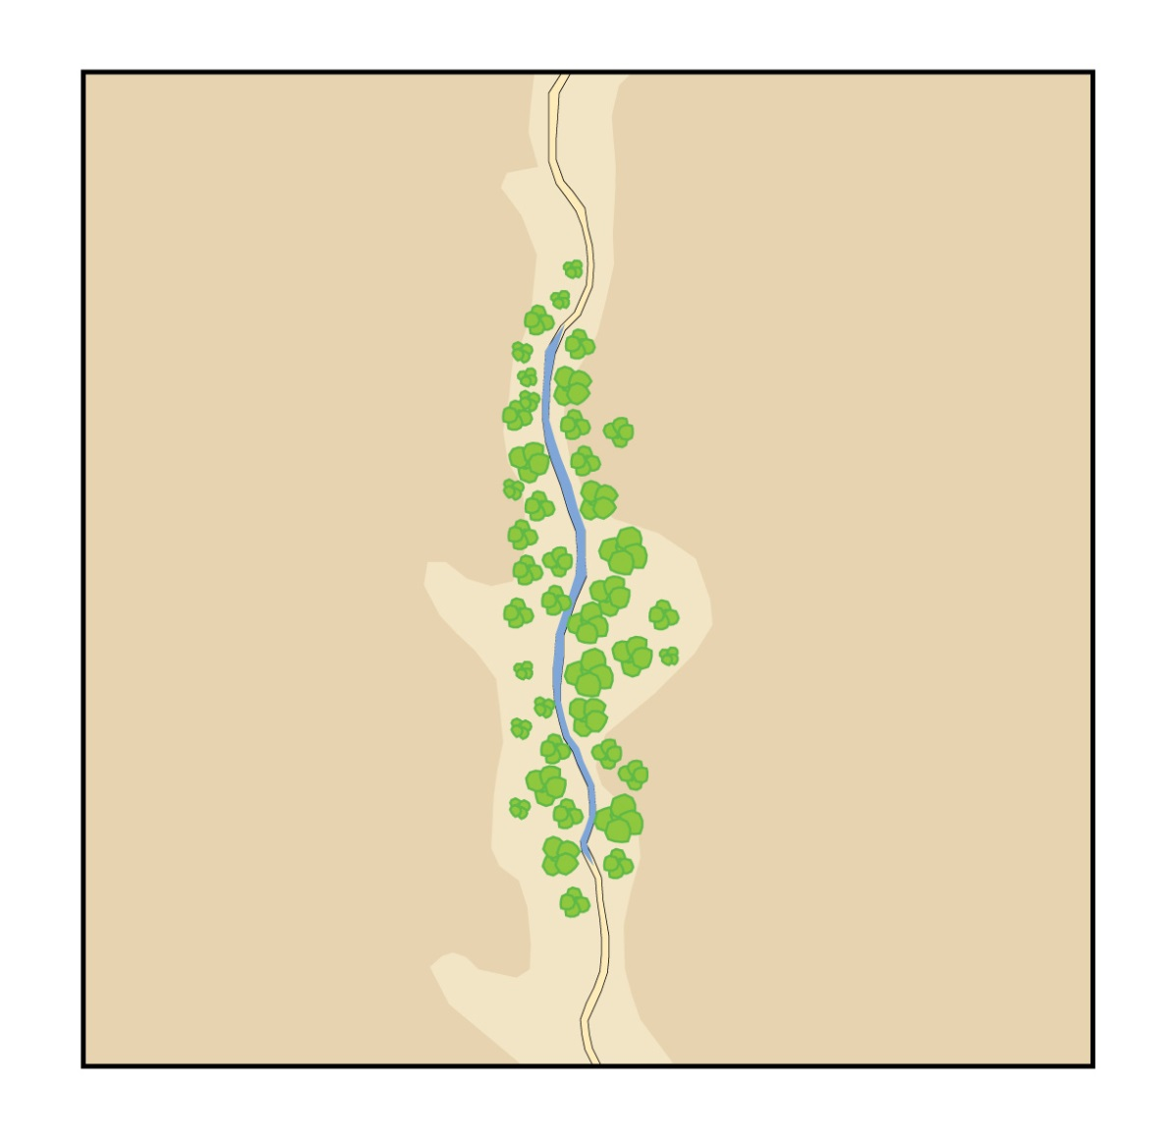
Case B
B— Topography or geology causes groundwater to discharge to a mostly ephemeral channel. Further downstream, the surface water goes back into the aquifer.
Notes:
Second example of a feature at which capture of streamflow does not occur is shown in the next three slides. Here, groundwater enters a stream and infiltrates to the aquifer further downstream. This feature is neither a source or sink in the aquifer, other than water that might be lost through ET.

Slide 16
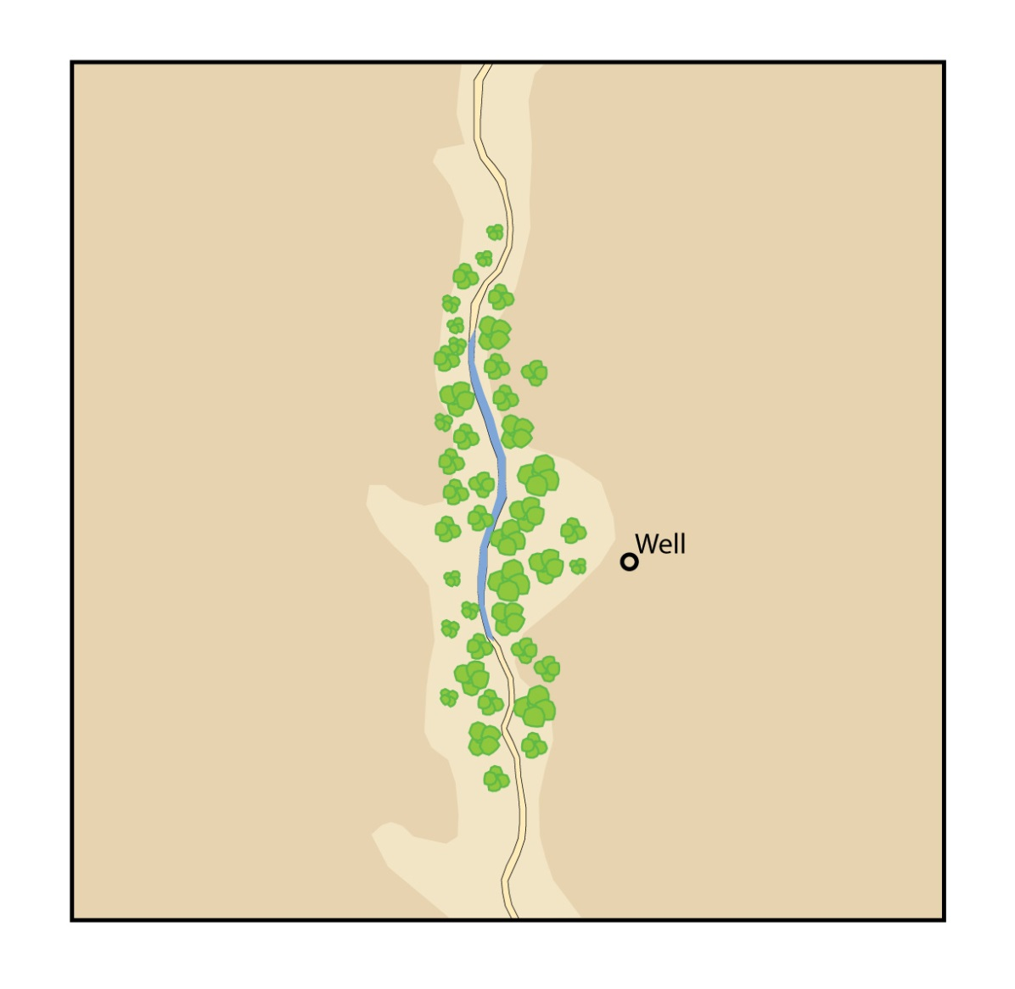
Case B
B—A well pumps water near the perennial part of the stream.
Notes:
Drawdown from a pumping well might cause less discharge and recharge back to the aquifer, but the feature is still not a source or sink, other than ET losses.

Slide 17
Case B
Without pumping, a certain amount of groundwater flows into the channel and back into the aquifer. Overall, the perennial reach is not a source or sink in the groundwater system.
Pumping can reduce the flow in the stream; therefore, streamflow depletion occurs from groundwater pumping.
With pumping, the depleted perennial reach still is not a source or sink in the groundwater system; therefore, capture of streamflow does not occur.
Again, there may be other sources of capture for this feature:
Reduced evapotranspiration along the stream reach.
Infiltration of runoff that was rejected when the water table was at the stream channel prior to pumping.
Notes:
This slide summarizes the effects that streamflow depletion from groundwater pumping occurs but capture does not occur. Same acknowledgement as before about possible capture from ET and previously rejected recharge.

Slide 18
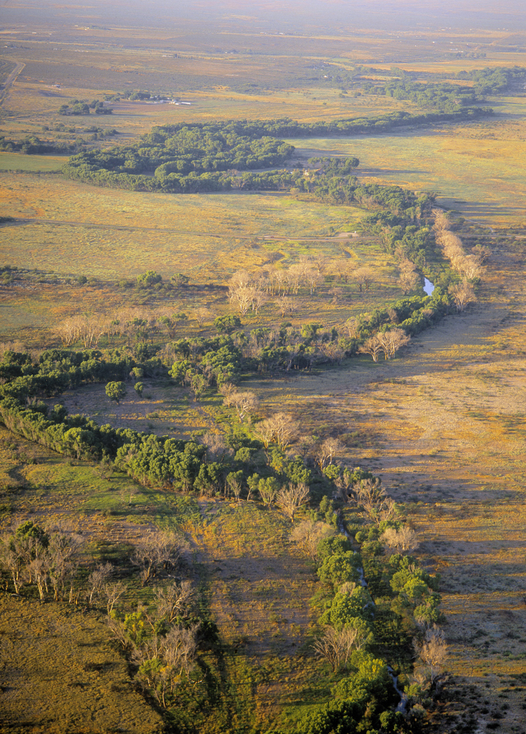
Upper San Pedro Basin, SE Arizona Photo by Michael Collier
Notes:
Photograph of the Upper San Pedro Basin. This and the next slide are introduced to show that the feature shown in the last example is of concern in some areas, particularly in the semi-arid parts of the western USA.

Slide 19
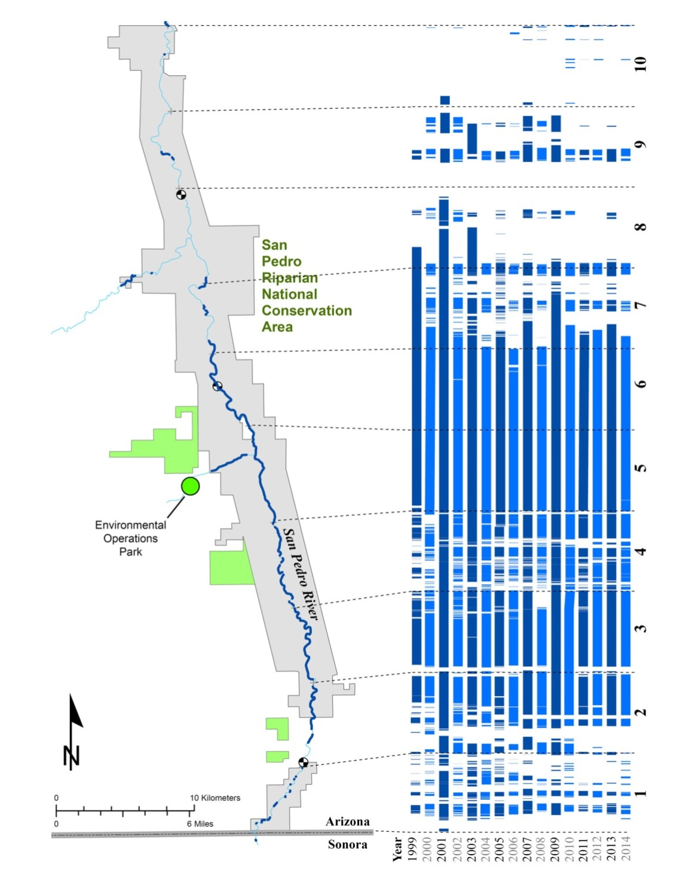
San Pedro annual wet-dry mapping
Source: Dale Turner, The Nature Conservancy
Notes:
The Nature Conservancy, partners, and citizen volunteers go out each year in early June to map where the San Pedro river is wet and where it is dry. The vertical bars of blue and white pattern show wet areas (blue) and dry areas (white) for years 1999-2014. We can see here that the upper San Pedro River is actually made up of a series of persistent wet and dry reaches.

Slide 20
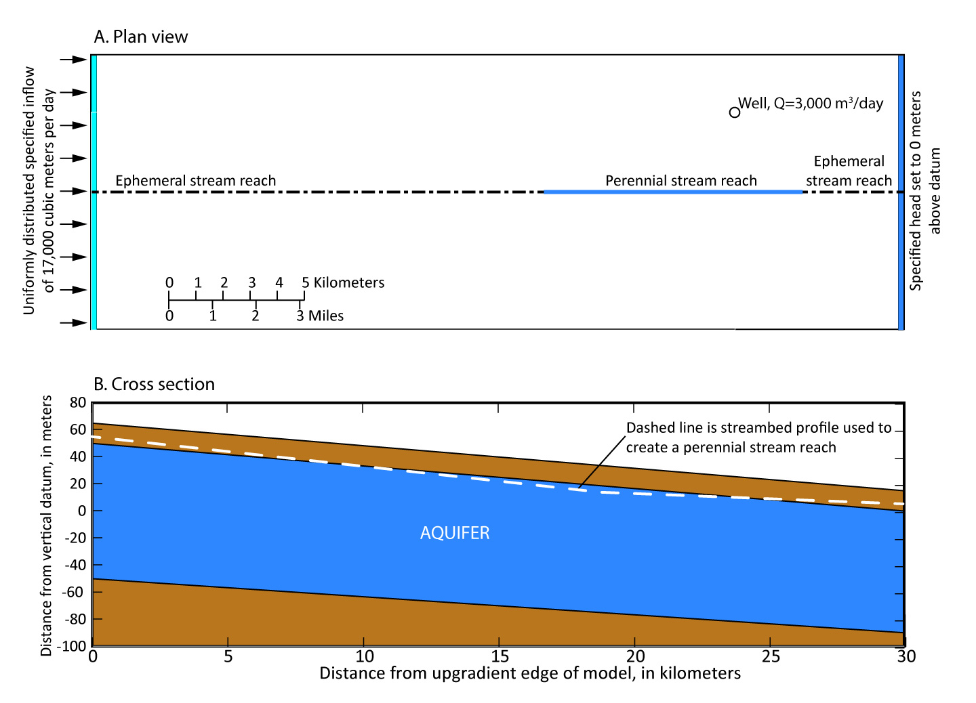
Test using a numerical model
Notes:
To help understand that capture of streamflow cannot occur from an isolated perennial stream reach, the numerical model shown here was constructed. A downvalley gradient exists from the recharge boundary on the left to the specified-head boundary on the right. The perennial reach in A was created by the streambed profile shown in B. The stream was simulated by the MODFLOW STR Package. Pumping rate is 3000 cubic meters per day

Slide 21
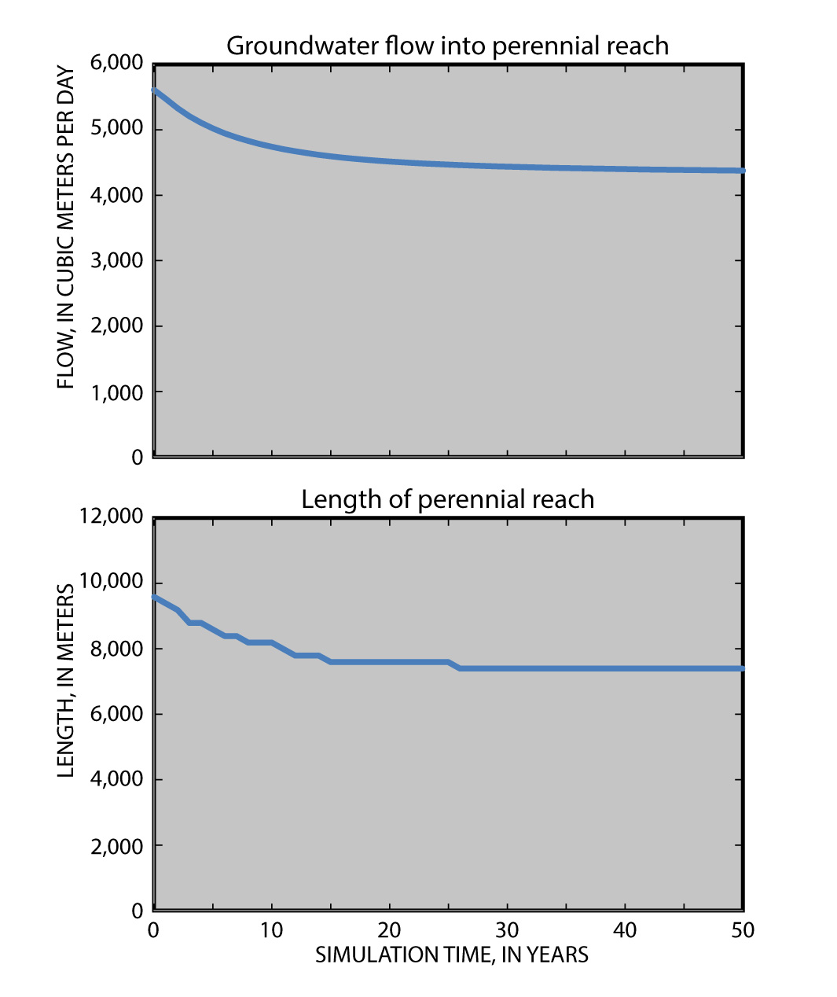
Test using a numerical model
Notes:
In the model, (GW flow into perennial reach) = (GW flow out of perennial reach). That rate, shown in A, declines over time since pumping begins. The length of the reach, shown in B, also declines with time. Here we have streamflow depletion.

Slide 22
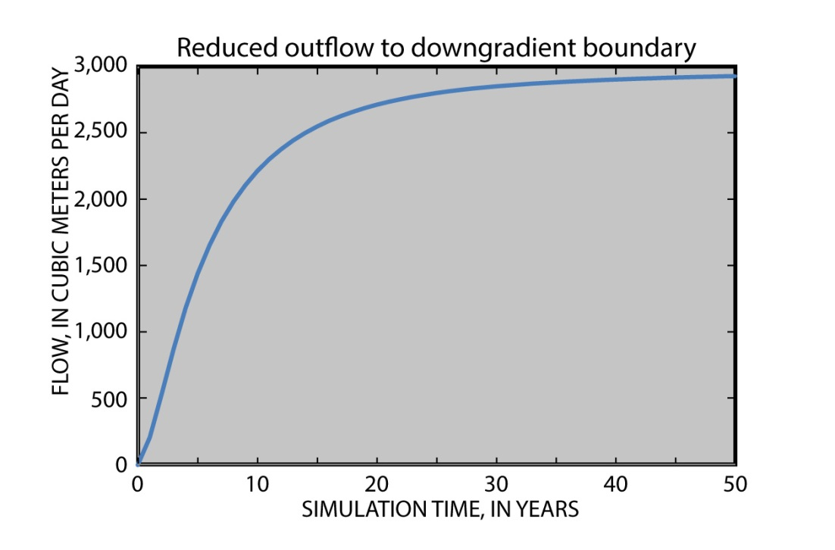
Test using a numerical model
Over time, reduced outflow to this boundary trends towards 3,000 m³/day
Flow in the perennial reach was reduced by the pumping well; however, all of the capture is from the lower head-dependent boundary. Capture from perennial stream reach therefore does not occur.
Notes:
Here we have the effect of the pumping on the downstream boundary.

Slide 23
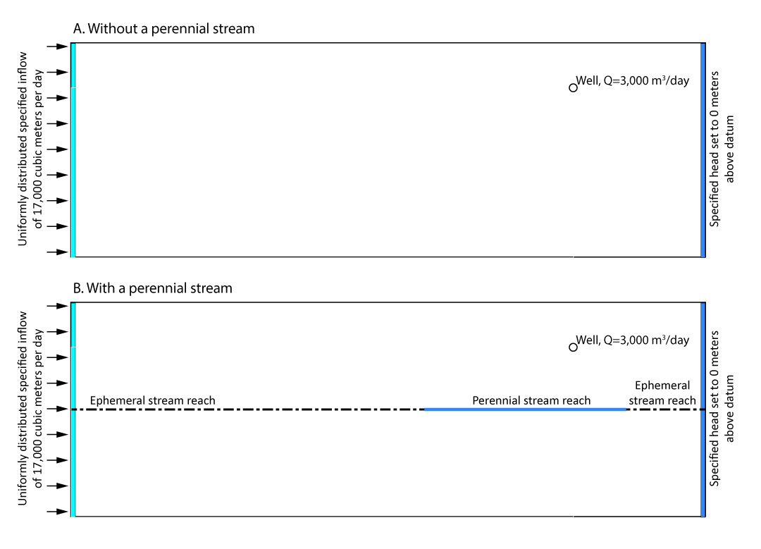
Test using a numerical model
How does the perennial reach affect the timing of capture?
Relative to A, will capture in B occur
At the same rate?
At a slower rate?
At a faster rate?
Notes:
We have established that capture from the perennial reach does not occur, and the next question is, “Does the perennial reach have an effect on the timing of capture that does occur?” Two model runs are set up to look at the timing of capture without the perennial reach (A) and with the perennial reach (B). Without a show of hands, think about relative rates of the progression of capture as the question here proposes.

Slide 24
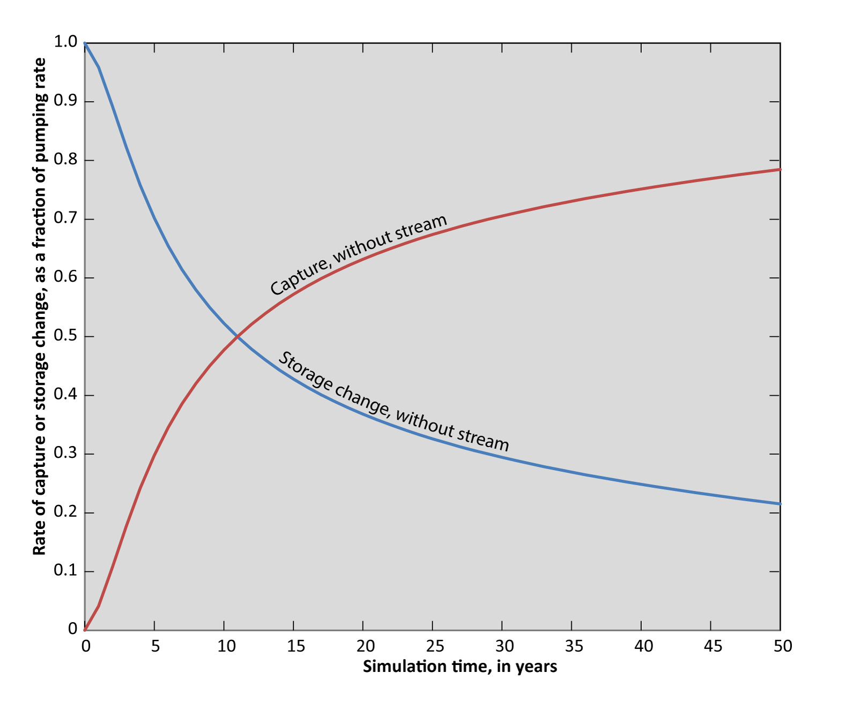
First, without perennial reach
Notes:
For case A, without the perennial reach, the time to depletion-dominated supply (50 percent capture) is around 11 years for this example.

Slide 25
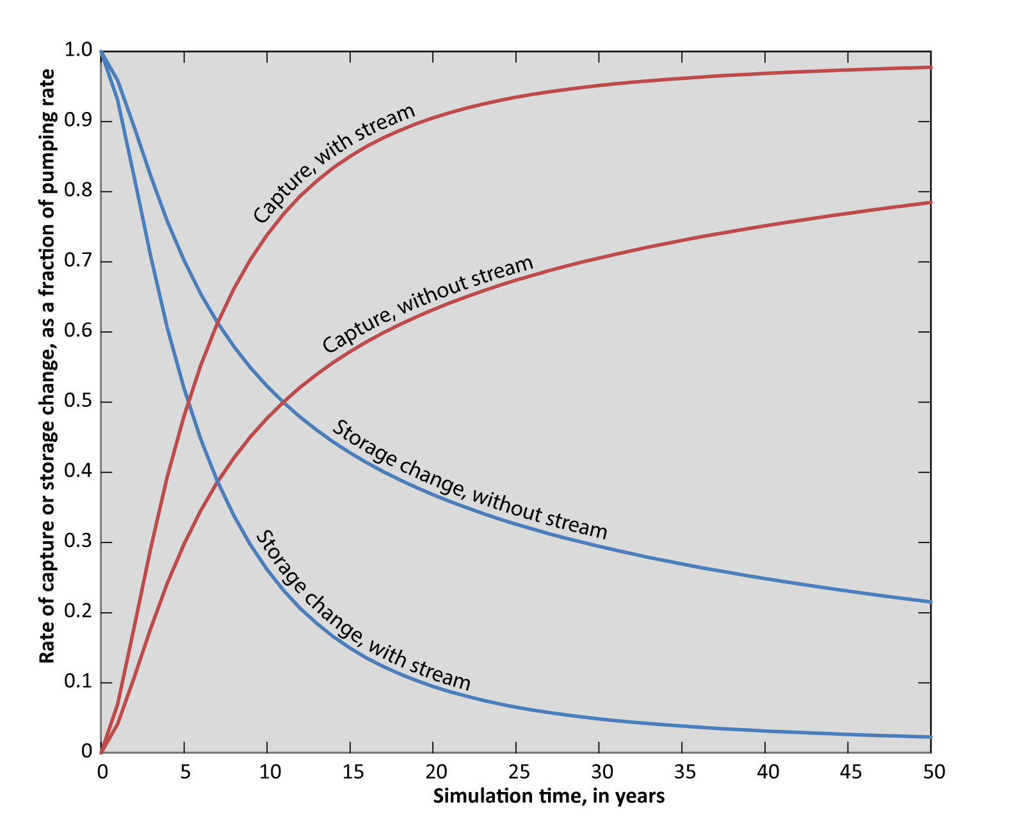
Now with the perennial reach
Notes:
The added curve shows the results with the perennial reach. The time to depletion-dominated supply, about 5 years, is much faster than without the perennial reach. We think the reason for faster capture is that the perennial reach limits the area of drawdown and storage change, causing a faster propagation of effects to the downstream boundary.

Slide 26
Similar cases where surface-water depletion is not capture
Lakes with both inflow from groundwater and outflow to groundwater
Springs at which the discharge recharges the aquifer
Any other feature at which there is a flow-through of groundwater
Cross section:
Well
Lake
Notes:
Features described here may be common in many regions of the USA.

Slide 27
Summary and Considerations for GW Models
Summary:
Capture of streamflow does not occur from streams that lose all water to the aquifer or from isolated perennial stream reaches.
Nearby groundwater pumping will cause streamflow depletion in these reaches.
Furthermore, these features can have effects on the timing of capture.
It is important to simulate these features using MODFLOW STR, SFR, LAK, or similar packages.
Notes:
Relating to second to last bullet, because they can be an artificial source of water. Relating to the last bullet, we are grateful to Dave Prudic, Rich Niswonger, Mike Merrit, Lenny Konikow, and others for developing the MODFLOW tools that allow us to correctly simulate the features described in this talk.

Slide 28
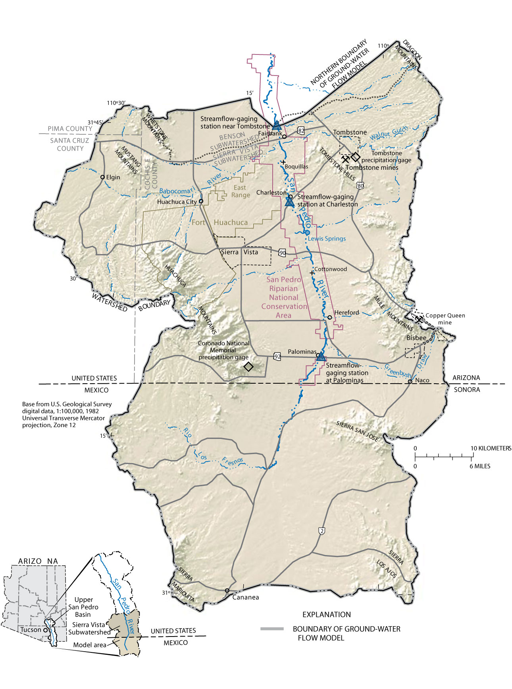
Artificial Boundary Conditions

Slide 29
Implications for the Upper San Pedro Basin
The river now is a series of perennial and ephemeral reaches– groundwater pumping can deplete streamflow but cannot capture surface-water flow.
All capture in the upper San Pedro Basin will be in the form of reduced evapotranspiration.
Timing of capture shown on the capture map should be thought of as applying to a well affecting the predevelopment system.
To better understand effects of pumping on the river, the model by Pool and Dickinson (2007) should be updated and expanded to the north to minimize effects of artificial boundaries.
Notes:
Relating to second to last bullet, because they can be an artificial source of water. Relating to the last bullet, we are grateful to Dave Prudic, Rich Niswonger, Mike Merrit, Lenny Konikow, and others for developing the MODFLOW tools that allow us to correctly simulate the features described in this talk.

