Slide 1
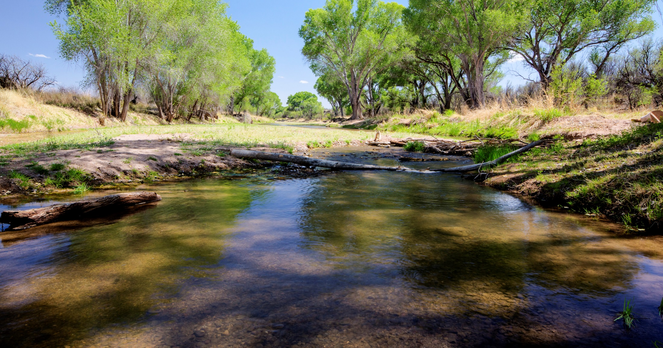
August 2018
San Pedro Riparian National Conservation Area
Draft Resource Management Plan/Environmental Impact Statement
Supporting Text

Slide 2
What is a Resource Management Plan?
Similar to city/county “land use plans”
High level framework that guides management decisions
Establishes goals and objectives for resource conditions
Does not authorize on- the-ground actions
Notes:
On the ground actions are managed through specific implementation activity plans and policy manuals.

Slide 3
Process: Where are we?
We are here
Public Scoping
Proposed RMP / Final EIS Released
Record of Decision/ Approved RMP
Alternatives Development
30-day Protest Period
Draft RMP/EIS Public Comment Period
April 2013 –
Dec 2013
Dec 2013 -
Fall
2017
June 29 – Sept. 27
2018
February
2019
April 2019
Notes:
After the ROD is signed is when the BLM focuses on implementation, such as Travel Management Plans and again engages the public.
Which ends on September 27th.
Explain that you establish standing by submitting comments during this public comment period if you want to file a protest.

Slide 4
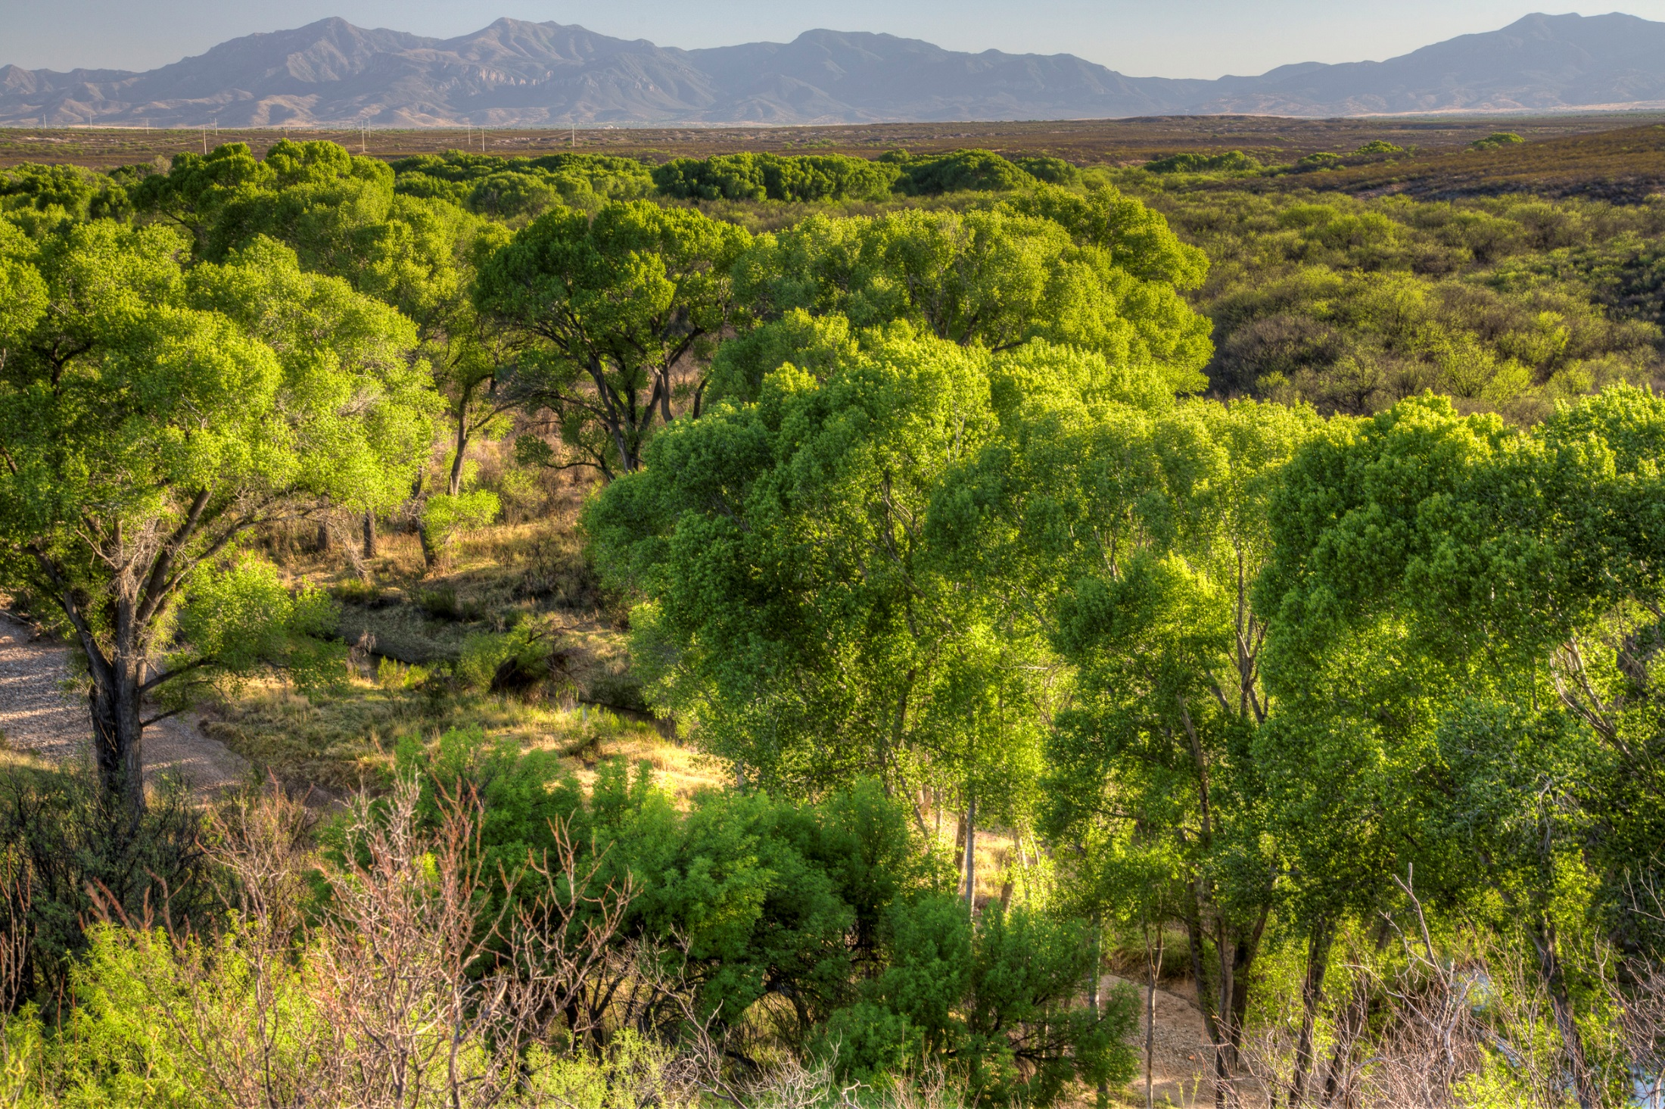
Enabling Legislation
The Arizona-Idaho Conservation Act of 1988 established the SPRNCA to “…protect the riparian area and the aquatic, wildlife, archaeological, paleontological, scientific, cultural, educational, and recreational resources of the public lands surrounding the San Pedro River in Cochise County, Arizona.”
“The Secretary shall only allow such uses of the conservation area as he finds will further the primary purposes for which the conservation area was established.”
Notes:
The SPRNCA was withdrawn from mineral entry as part of the enabling legislation. That decision could only be changed through an act of congress.

Slide 5
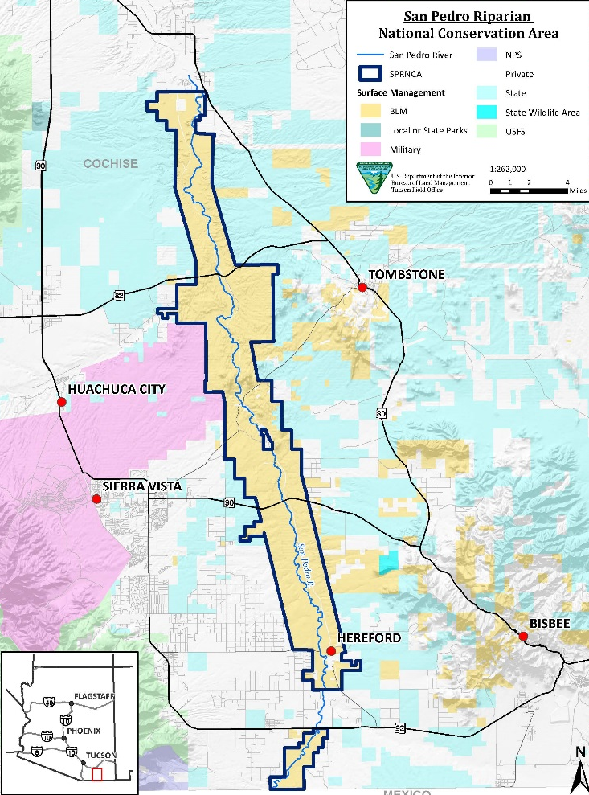

Slide 6
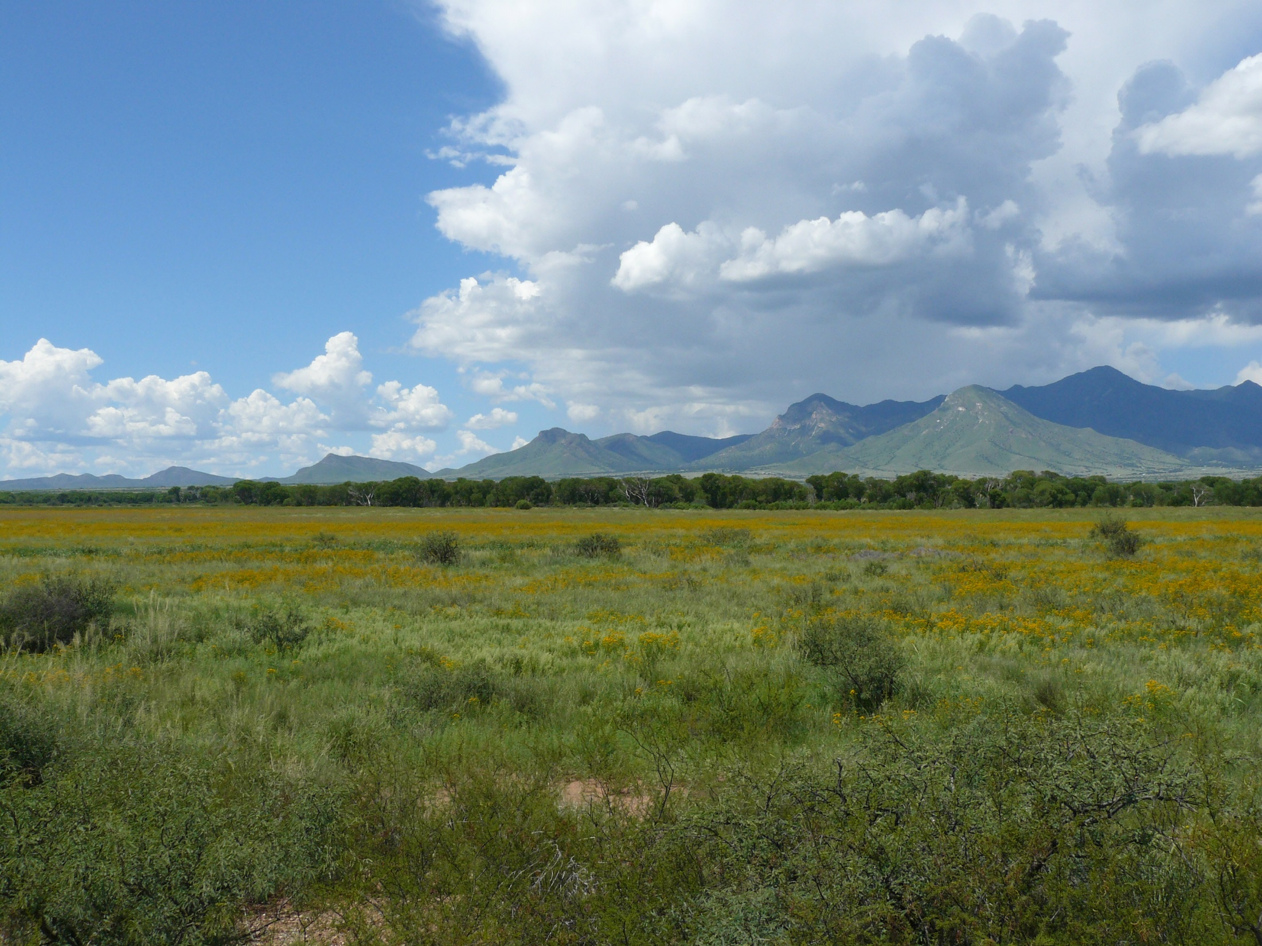
Why is an RMP Necessary?
Update decisions from the 25-year old Safford District Resource Management Plan & San Pedro River Riparian Management Plan
Address changing resource conditions
Increased population growth
Increased demand for access
Increased demand for groundwater that could impact the riparian, wildlife, and recreational values of the SPRNCA

Slide 7
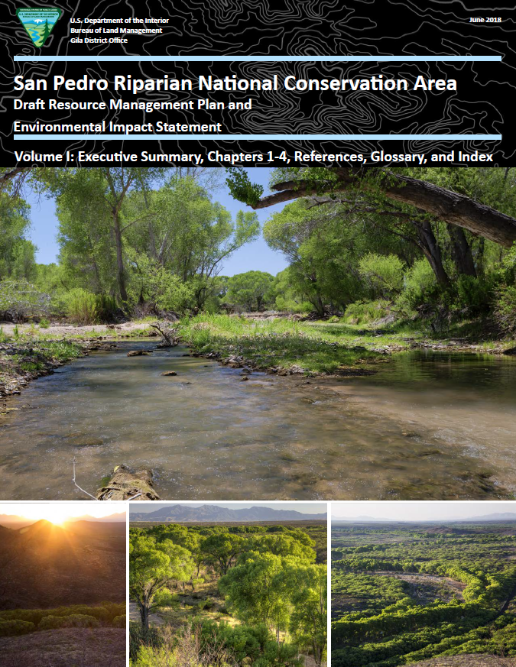
Draft RMP/EIS Organization
Volume I
Executive Summary
Chapter 1 – Introduction
Chapter 2 – Alternatives
Chapter 3 – Affected Environment & Environmental Consequences
Chapter 4 – Consultation and Coordination
Volume II
Maps
Appendices

Slide 8
What are Alternatives?
Each alternative provides a unique mix of management strategies and allowable land uses
The “no action” alternative depicts current management and decisions moving forward unchanged
All other alternatives depict modifications or additions to the outdated plans
Reasonable range of alternatives
Provides context for impacts
Notes:
Each alternative is a different plan for managing the SPRNCA

Slide 9
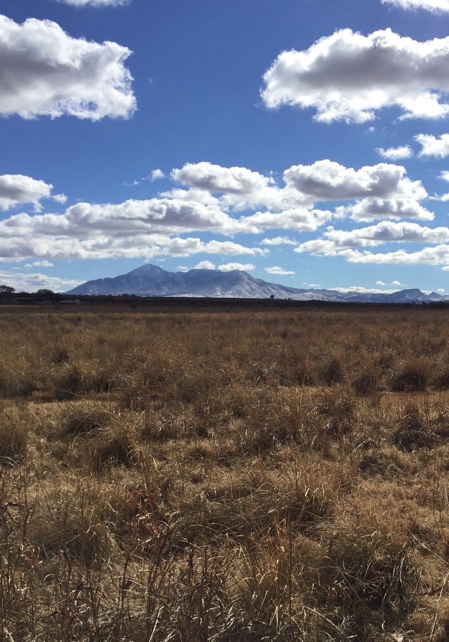
Chapter 2: Alternatives
Alternative A – Current management (No Action)
Alternative B – Increased use
Alternative C – Balance appropriate use levels with the established conservation values
Alternative D – Focus on protective designations and “light on the land” management

Slide 10
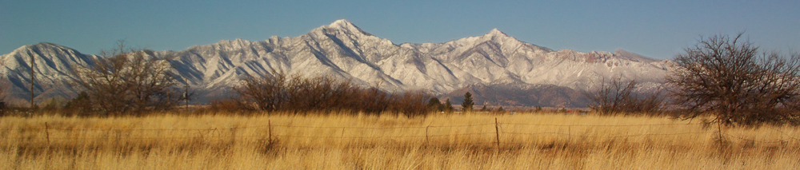
Alternative A – No Action
Continuation of existing management under the Safford RMP (1992 and 1994) and the San Pedro River Riparian Management Plan (1989)
Neither sets desired outcomes for resource management or uses nor addresses new issues
Existing levels of access and recreation
Livestock grazing would occur on four existing allotments
Restoration on a case-by-case basis
No acreage to protect wilderness characteristics
Three Areas of Critical Environmental Concern would continue
Notes:
Explain ACECs- what they are
Lands with wilderness characteristics explain what those are

Slide 11
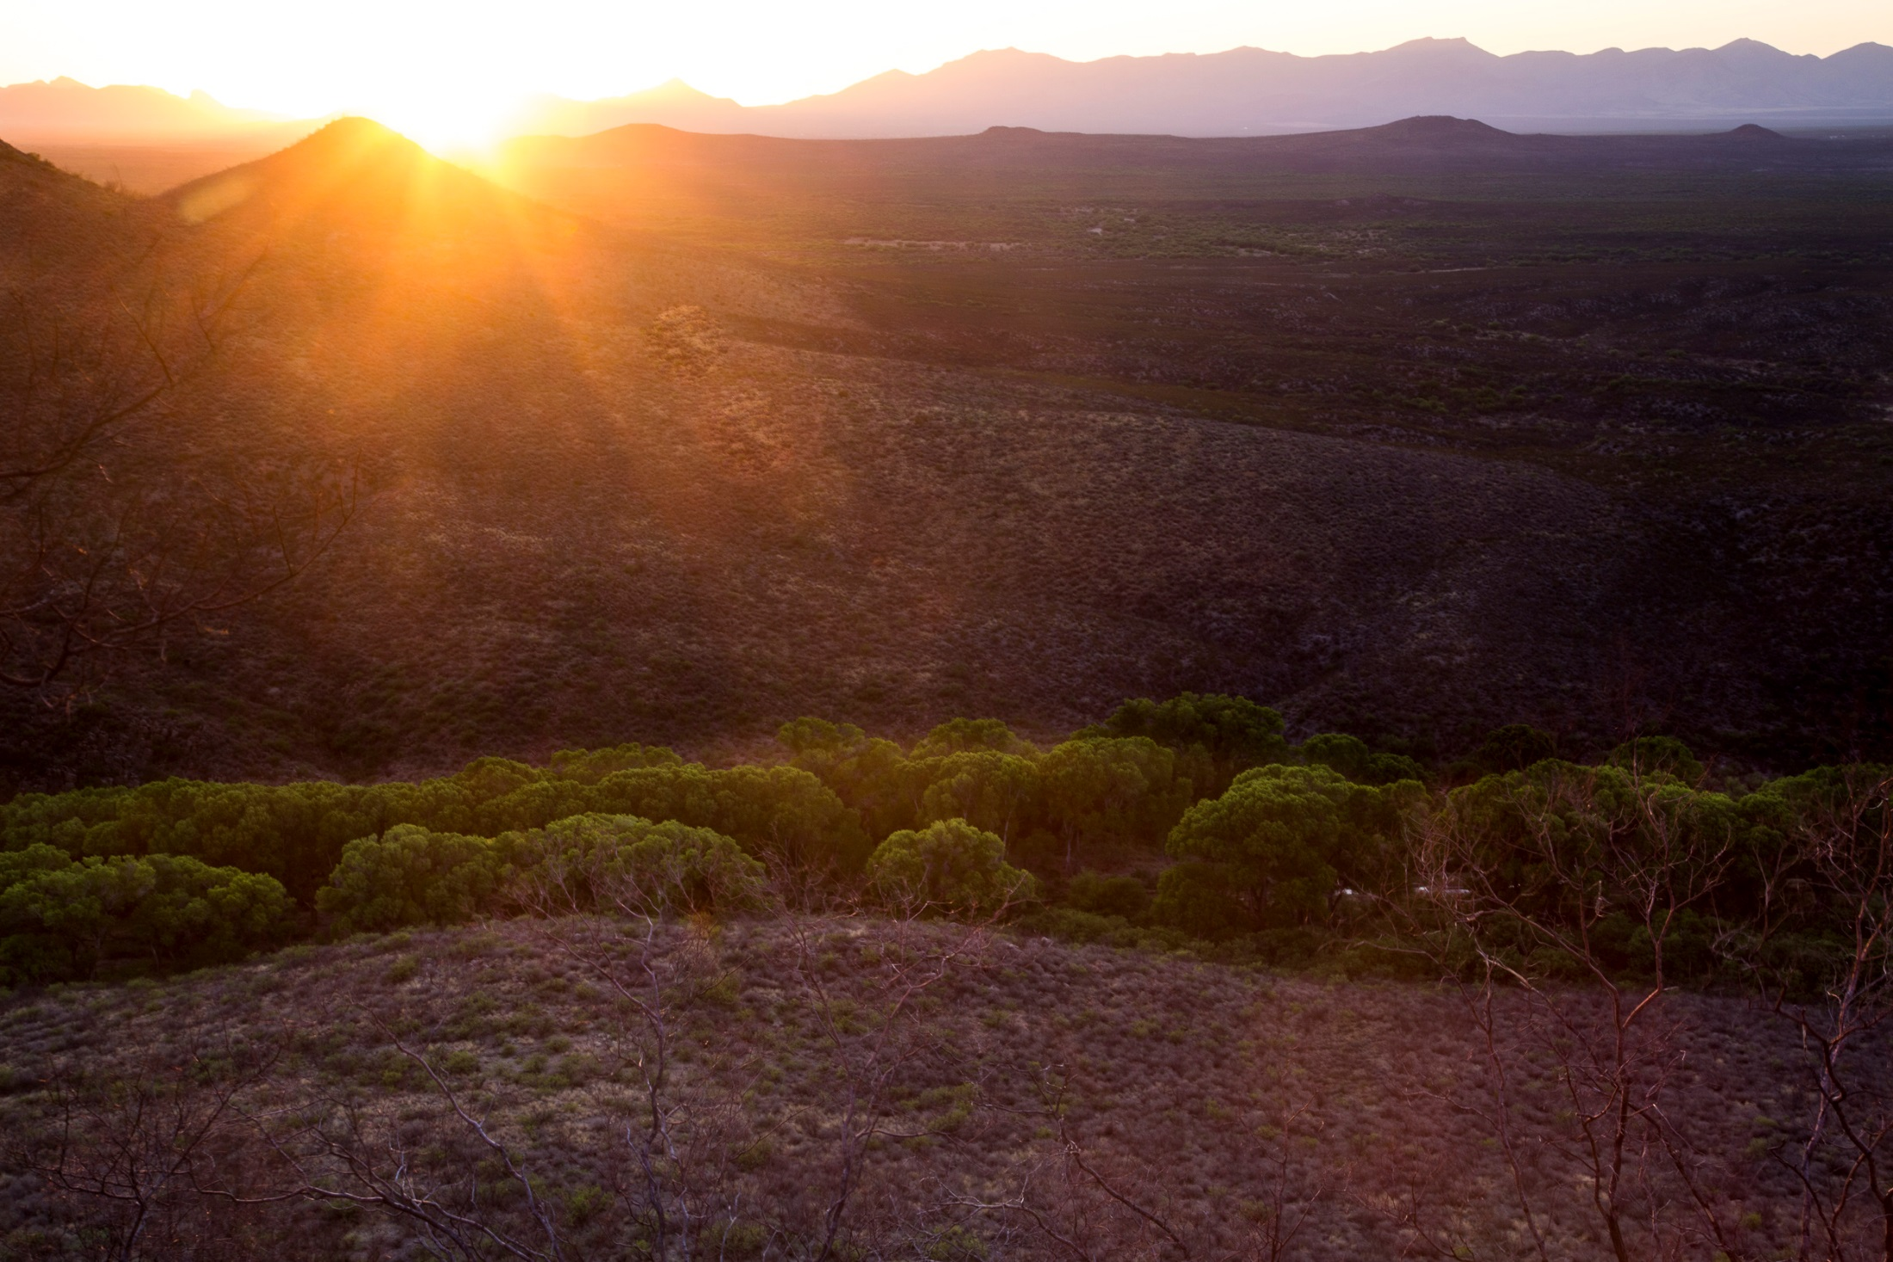
Alternative B
Desired outcomes:
Broadest array of management tools
Vegetation treatments
Water recharge enhancements
Increased public access
Livestock grazing across the entire SPRNCA
No acreage to protect wilderness characteristics
No Areas of Critical Environmental Concern
The San Pedro River would be suitable as recreational
The Babocomari River would not be suitable

Slide 12
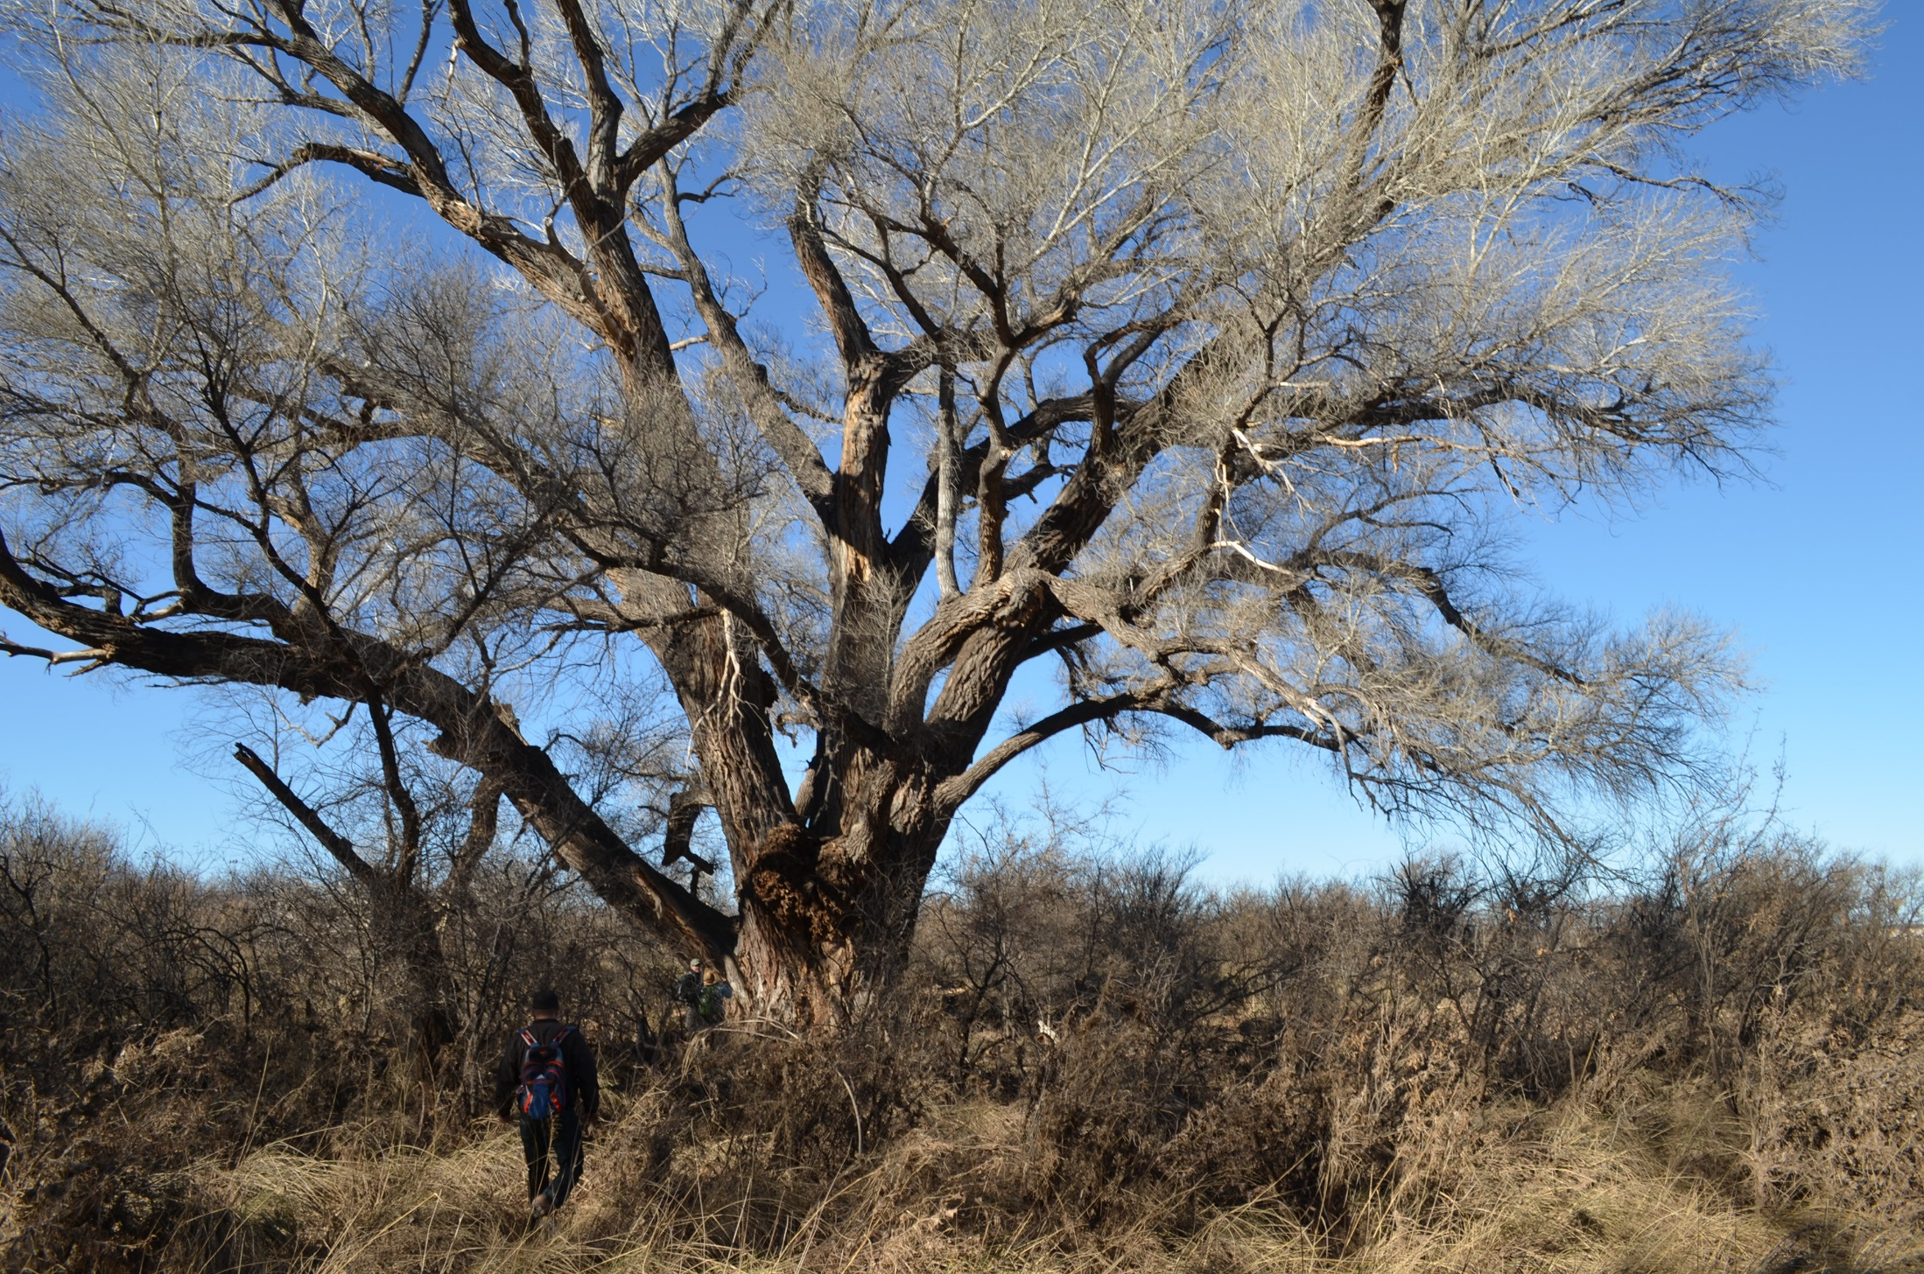
Alternative C – Preferred Alternative
Desired outcomes:
Broadest array of management tools
Vegetation treatments
Water recharge enhancements
Mix of recreational opportunities
Livestock grazing in the uplands
No acreage to protect wilderness characteristics
No Areas of Critical Environmental Concern
The San Pedro River would be suitable as recreational
The Babocomari River would be suitable as recreational

Slide 13
Alternative D
Desired outcomes:
“Light on the land” management
Focus on undeveloped recreational opportunities
No livestock grazing
23,810 acres would be managed to protect wilderness characteristics
The three existing Areas of Critical Environmental Concern would be expanded
Two additional Areas of Critical Environmental Concern
The San Pedro River would be suitable as recreational, scenic, and wild
The Babocomari River would be suitable as scenic

Slide 14
Alternatives Summary
Alternative A No Action | Alternative B | Alternative C Preferred Alternative | Alternative D
Existing levels of public access | Increased public access | Balance between resource protection and public access | Focus on resource protection, conservation, and protective designations
Restoration on a “case-by-case” basis | Broadest array of management tools for restoration | Broadest array of management tools for restoration | “Light on the land” restoration approach
Livestock grazing would continue on existing allotments | Livestock grazing would occur across the entire SPRNCA | Livestock grazing would occur in upland areas compatible with the Conservation Values | No livestock grazing

Slide 15
Chapter 3: Effects Analysis Orientation
Environmental consequences describe impacts to a resource or resource use from other resource programs
Reasonably Foreseeable Development scenarios used to estimate impacts
Livestock grazing
Recreation
Impacts to
Vegetation

Slide 16
How to make Effective Comments
Suggested
Specific changes
Identify:
Where the issue or error is located (chapter, page)
Why
Alternative ideas
Constructive solutions with documentation or resources
Not Suggested
Vague statements
Numerous comments expressing the same concern or issue is considered to be one comment
Avoid using form letters

Slide 17
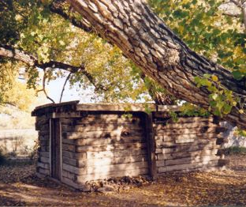
Specific Comments
Question the accuracy of information
Question the adequacy, methodology, or assumptions
Present valid new information
Present reasonable alternatives

Slide 18
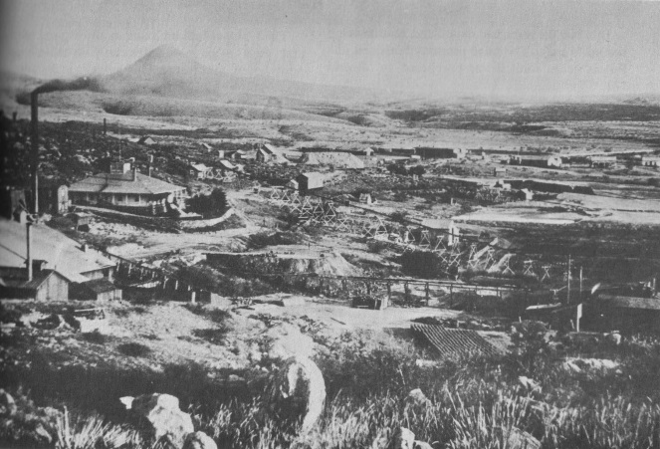
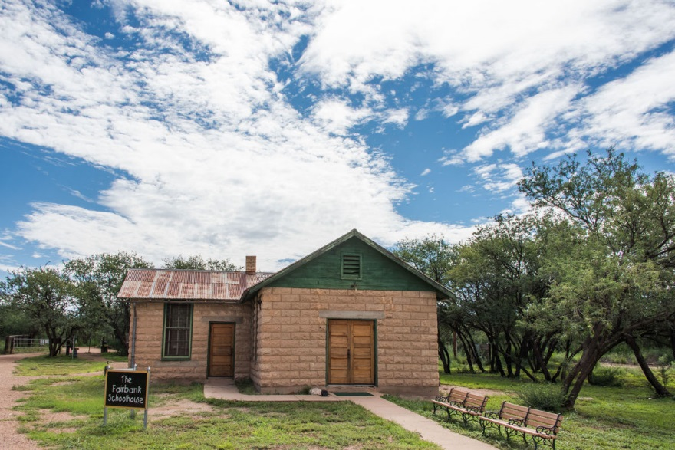
How can you help us?
Focus on Chapter 3
Provide your comments to help us make the best decisions
What else do we need to consider?

Slide 19
How to submit comments
ePlanning page: https://go.usa.gov/xUYjE
If you don’t have internet access-
Mail comments to:
Attn: Amy Markstein
3201 E. Universal Way
Tucson, AZ 85756
Questions? amarkstein@blm.gov

Slide 20
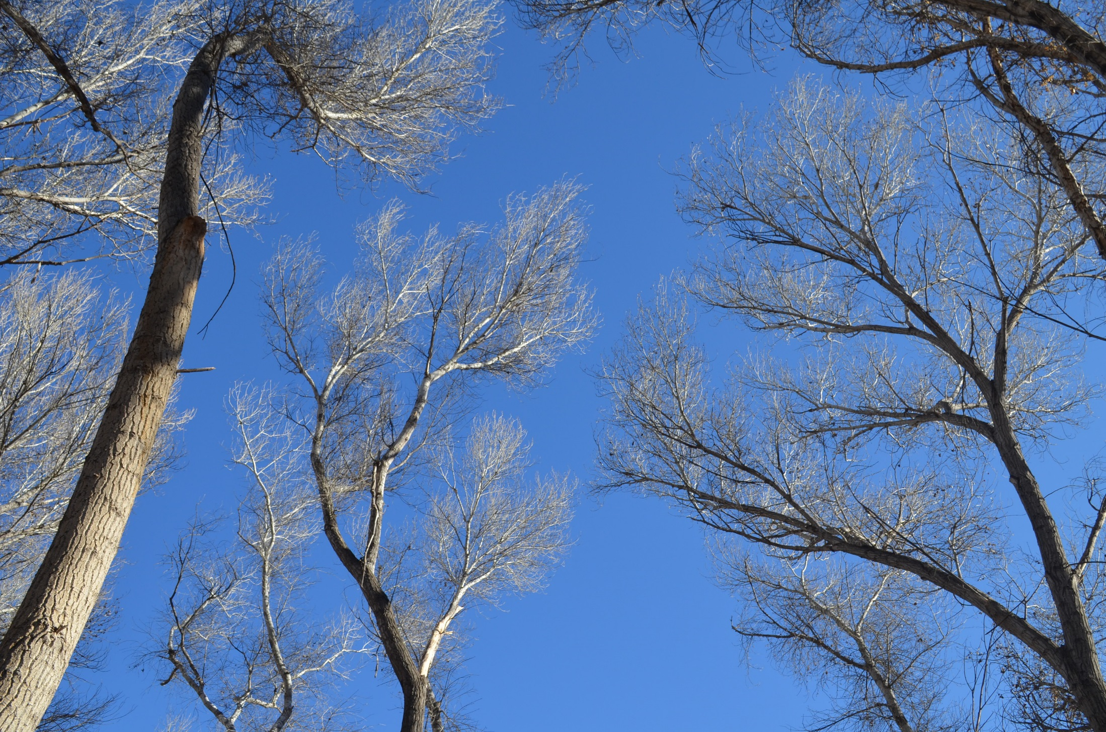
Public meeting schedule
July 30th – Sierra Vista, 5:30-7 p.m., Sierra Vista Police Department, 911 N. Coronado Drive, Sierra Vista, Ariz.
August 8th – Benson, 5:30-7 p.m., Cochise College, 1025 South State Route 90, Benson, Ariz.
August 22nd – Sierra Vista,5:30-7 p.m., Sierra Vista Police Department, 911 N. Coronado Drive, Sierra Vista, Ariz.
August 23rd – Tucson, 5:30-7 p.m., Pima Community College, 401 N. Bonita Ave., Tucson, Ariz.

Slide 21
Questions
Notes:
Turn over to the facilitator for the Q & A session.

Slide 22
Process: Where are we?
We are here
Public Scoping
Proposed RMP/Final EIS Released
Record of Decision/ Approved RMP
Alternatives Development
30-day Protest Period
Draft RMP/EIS Public Comment Period
April 2013 –
Dec 2013
Dec 2013 -
Fall
2017
June 29 – Sept. 27
2018
February
2019
April 2019
Notes:
After the ROD is signed is when the BLM focuses on implementation, such as Travel Management Plans and again engages the public.
Any entity that has submitted a comment throughout the process and has standing can file a protest.

Slide 23
Next Steps
July 30th – Sierra Vista, 5:30-7 p.m., Sierra Vista Police Department, 911 N. Coronado Drive, Sierra Vista, Ariz.
August 8th – Benson, 5:30-7 p.m., Cochise College, 1025 South State Route 90, Benson, Ariz.
August 22nd – Sierra Vista, 5:30-7 p.m., Sierra Vista Police Department, 911 N. Coronado Drive, Sierra Vista, Ariz.
August 23rd – Tucson, 5:30-7 p.m., Pima Community College, 401 N. Bonita Ave., Tucson, Ariz.
ePlanning page: https://go.usa.gov/xUYjE
If you don’t have internet access-
Mail comments to:
Attn: Amy Markstein
3201 E. Universal Way
Tucson, AZ 85756
Questions?
amarkstein@blm.gov

