Slide 1
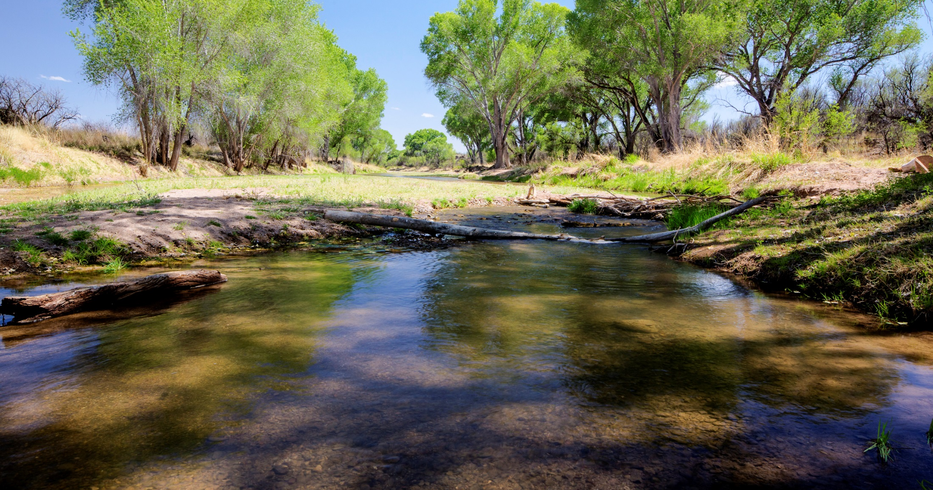
May 2019
San Pedro Riparian National Conservation Area
Proposed Resource Management Plan/Final Environmental Impact Statement
Supporting Text

Slide 2
Process: Where are we?
We are here
Public Scoping
Proposed RMP / Final EIS Released
Record of Decision/ Approved RMP
Alternatives Development
30-day Protest Period
Draft RMP/EIS Public Comment Period
April 2013 –
Dec 2013
Dec 2013 -
Fall
2017
June 29 – Sept. 27
2018
April
2019
April 26 – May 28
2019
July 2019
Notes:
After the ROD is signed is when the BLM focuses on implementation, such as Travel Management Plans and again engages the public.
Which ends on September 27th.
Explain that you establish standing by submitting comments during this public comment period if you want to file a protest.

Slide 3
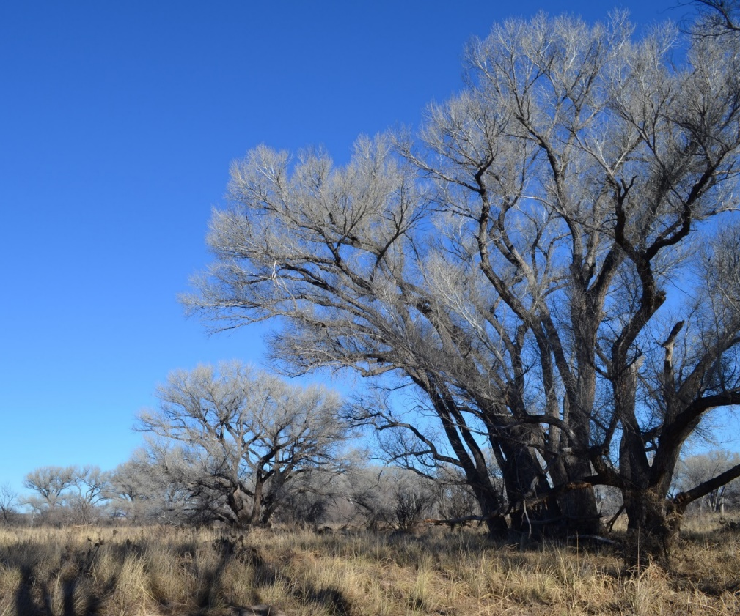
Summary of public comments
1,000 unique comments
Summarized in Appendix V
Livestock grazing
Compliance with enabling legislation
Hunting
Public safety at high use visitor sites
Climate change
Lacking information on impacts to SPRNCA resources
Concerns about water

Slide 4
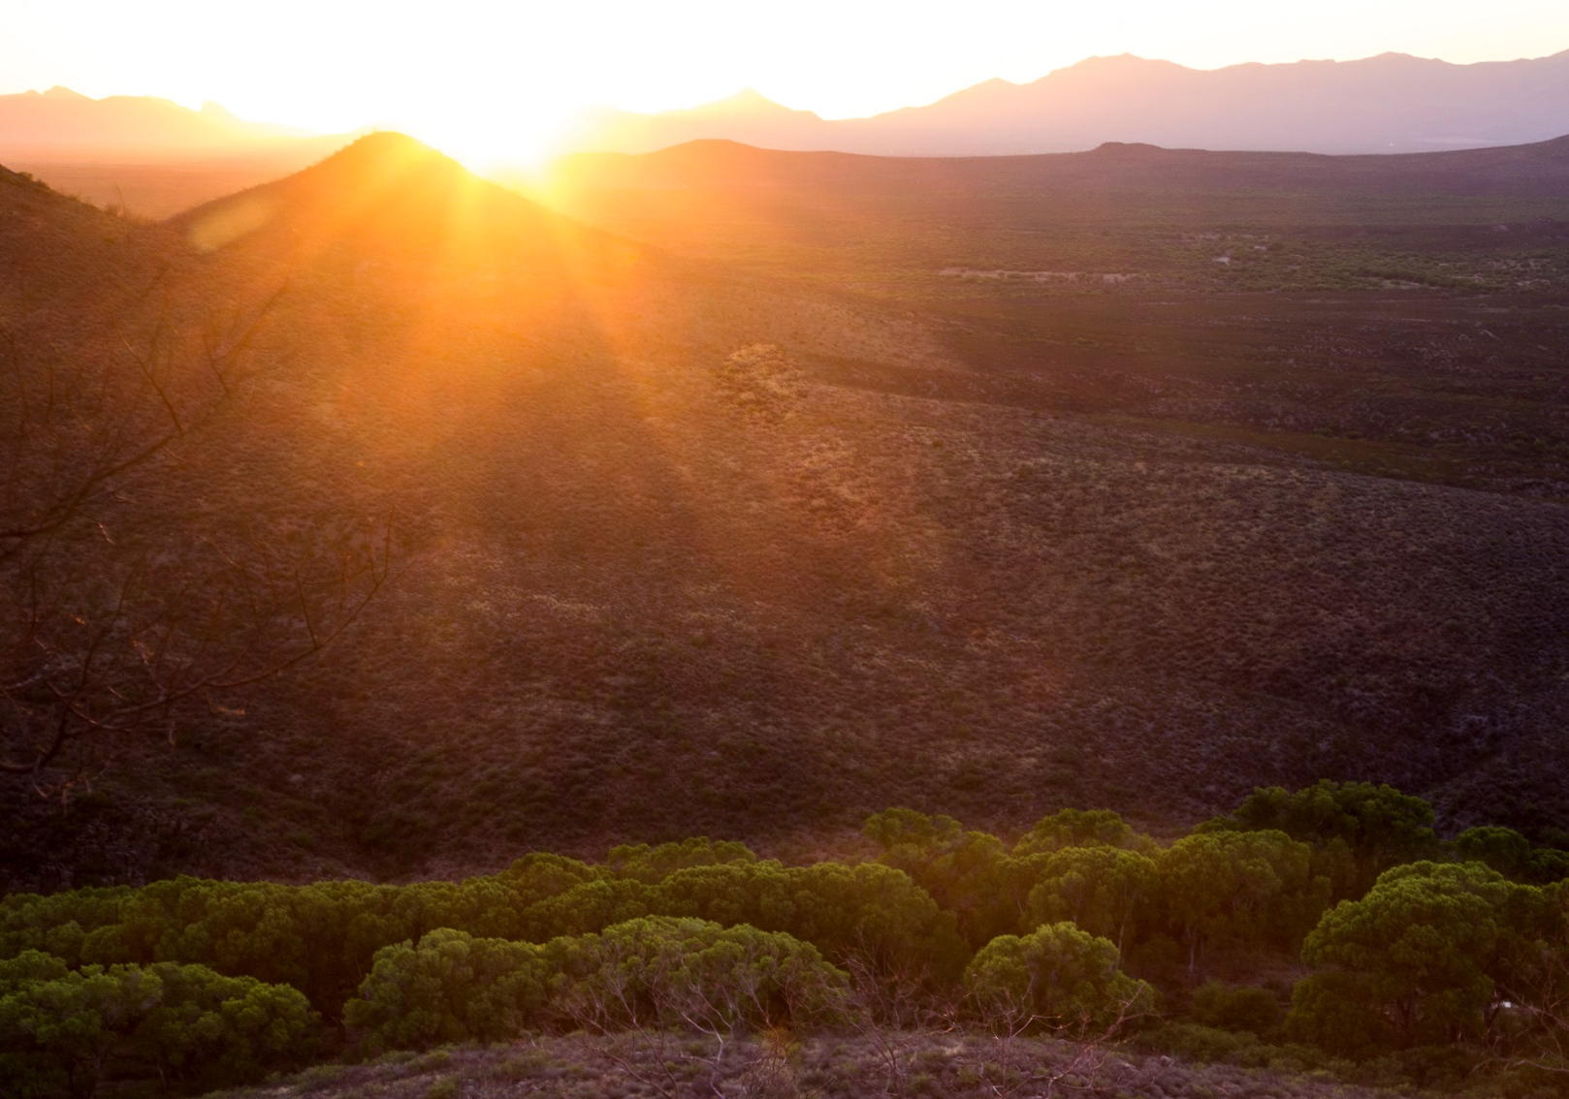
Changes from Draft to Proposed/Final
A modified version of Alternative C (Alternative C with the livestock grazing allocation from Alternative A)
Allocate leased livestock grazing on existing allotments (~7,000 acres)
Collaborative adaptive management approach in implementation
Area around the San Pedro house would not be available for hunting with firearms
Updated climate change analysis with temperature and precipitation trend data

Slide 6
How is a protest period different from a comment period?
Must have standing to submit a protest
Governed by BLM planning regulations
Must submit in writing to BLM WO office
Or electronically through ePlanning
Only 30-days
Addressed in protest report

Slide 7
How to submit a protest
ePlanning page: https://go.usa.gov/xUYjE
If submitting a protest in hard copy, it must be mailed to one of the following addresses:
Regular Mail: Overnight Delivery:
BLM Director (210) BLM Director (210)
Attention: Protest Coordinator Attention: Protest Coordinator
P.O. Box 71383 20 M Street SE, Room 2134LM
Washington, D.C. 20024-1383 Washington, D.C. 20003
Protest period: April 26 – May 28, 2019

Slide 8
Questions
Notes:
Turn over to the facilitator for the Q & A session.

